Slide 1

IF/THEN®
Gender Representation Toolkit
Staff Session:
Planning and Prep
Notes:
This session is an opportunity for data collectors to become more familiar with the IF/THEN Gender Representation Toolkit assessment tool, including the language used and the process of collecting data.

Slide 2
Session Schedule
Segment | Goal | Time
Introduction | Introduce the goals of the IF/THEN® Gender Representation Toolkit Discuss organizational goals for using the Toolkit Provide context for why this work matters | 10 – 20 min
Guidelines for Using the Tool | Review definitions and rules for each category of the Toolkit Discuss how “notes” page can be used | 15 – 25 min
Next Steps | Provide directions on where, when, and how each person will collect data Allow staff opportunity to predict what they will find | 5 – 15 min
Notes:
Guidelines for using the tool: Review definitions and rules for age, gender, STEM, space, element, etc.

Slide 3

The IF/THEN® Initiative aims to advance women in STEM through three primary efforts:
  Highlighting women working in these fields as role models
  Inspiring young women to learn about STEM careers
  Convening cross-sector partnerships to illuminate the importance of STEM everywhere

Slide 4
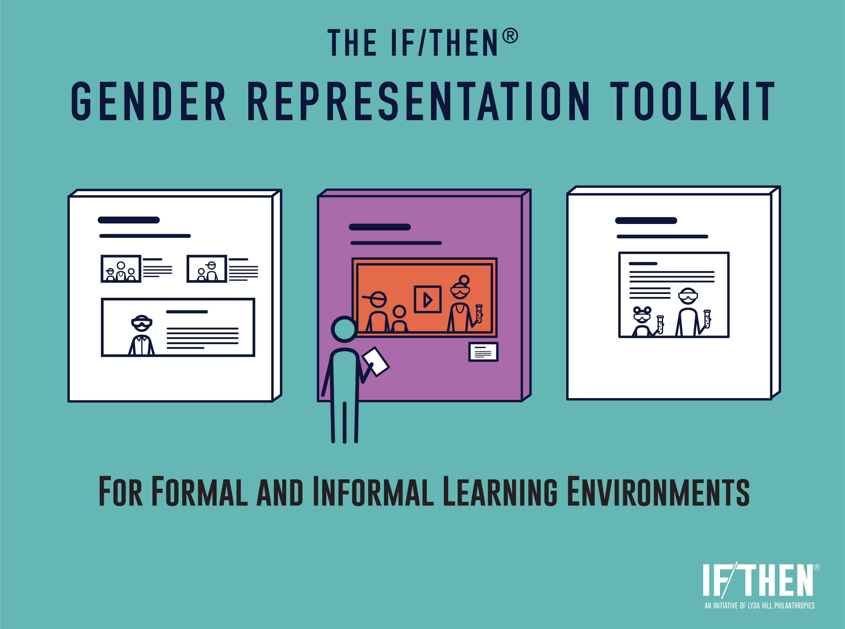
Goals of the IF/THEN® Gender Representation Toolkit
Help formal and informal educators collect data on their visual representation of gender
Prompt conversations among staff about gender equity and support broader Diversity, Accessibility, Inclusion, and Equity efforts.
Encourage educators to improve gender representation in their materials and visual communications by leveraging the IF/THEN® Collection or other related resources.

Slide 5
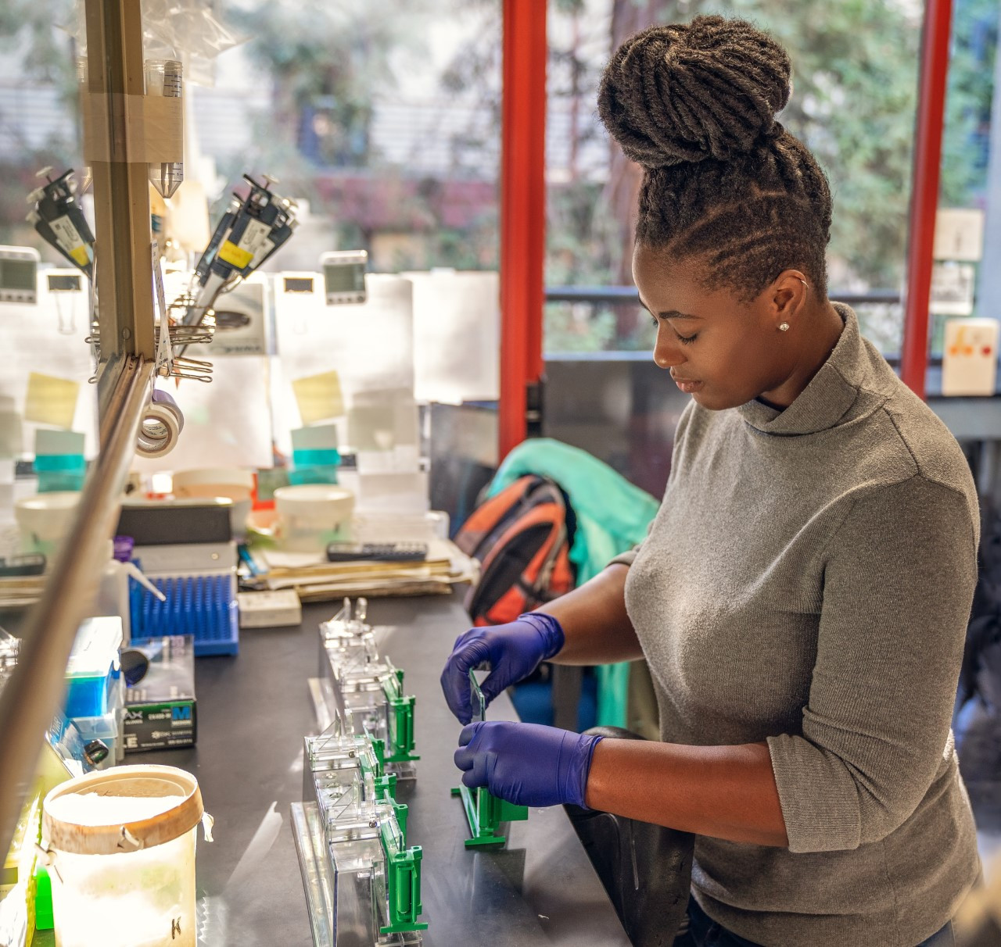
Why Does Representation Matter?
Women make up half of the total U.S. college-educated workforce, but only 28% of the science and engineering workforce.
Educators have a part to play in ensuring that groups underrepresented in STEM fields are more visible to their young audiences. The images and videos displayed in classrooms, in community centers, and elsewhere have the potential to inspire students and others who visit these spaces.
Our hope is that everyone can see themselves reflected in images and be motivated to consider education and careers in STEM fields.

Slide 6
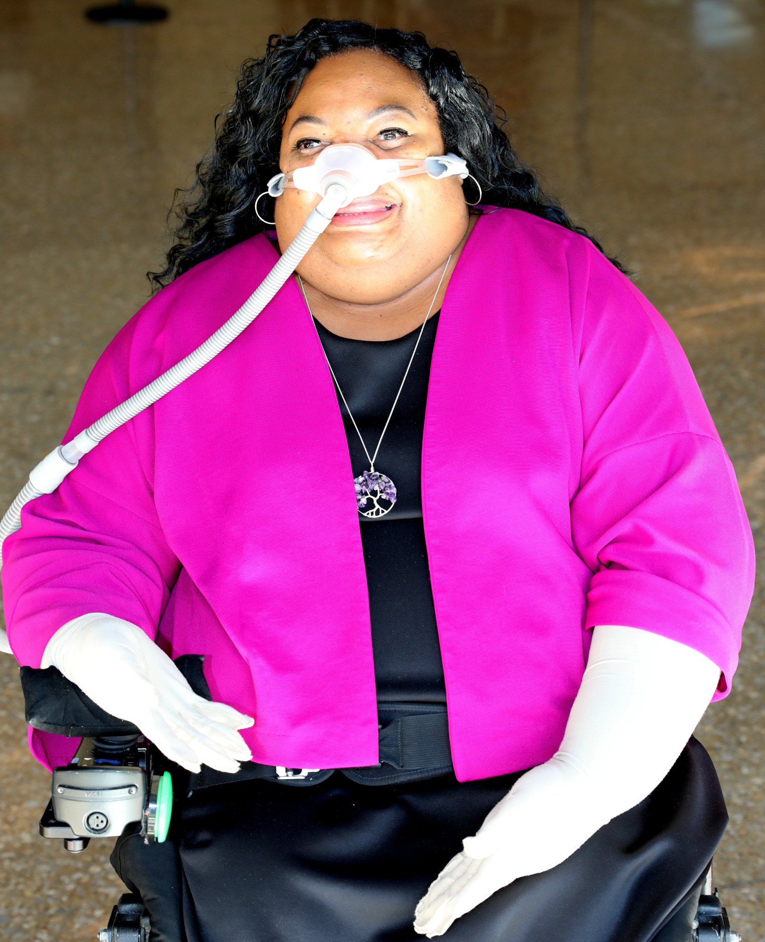
Why Does Representation Matter?
In the words of filmmaker, author, and AAAS IF/THEN® Ambassador Crystal Emery:
In our society, people of color, those with disabilities and women are all underrepresented minorities (URMs) in the area of STEM, and beyond. But these URMs have the untapped potential and hidden talent our world needs. My hope is that my work will change how people view STEM careers by giving them new images to internalize.
“
”
Photo courtesy of IF/THEN ®

Slide 7
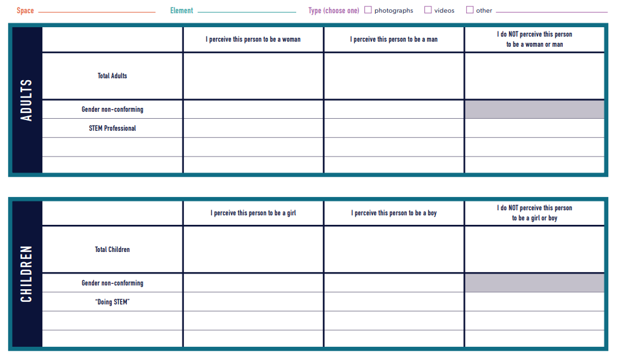
How to Use the Assessment Tool
The tool is designed to collect data on images or videos of people by using tally marks in each box.
One sheet can collect data on many images or videos, and you can print as many sheets as needed to collect data from each space.

Slide 8
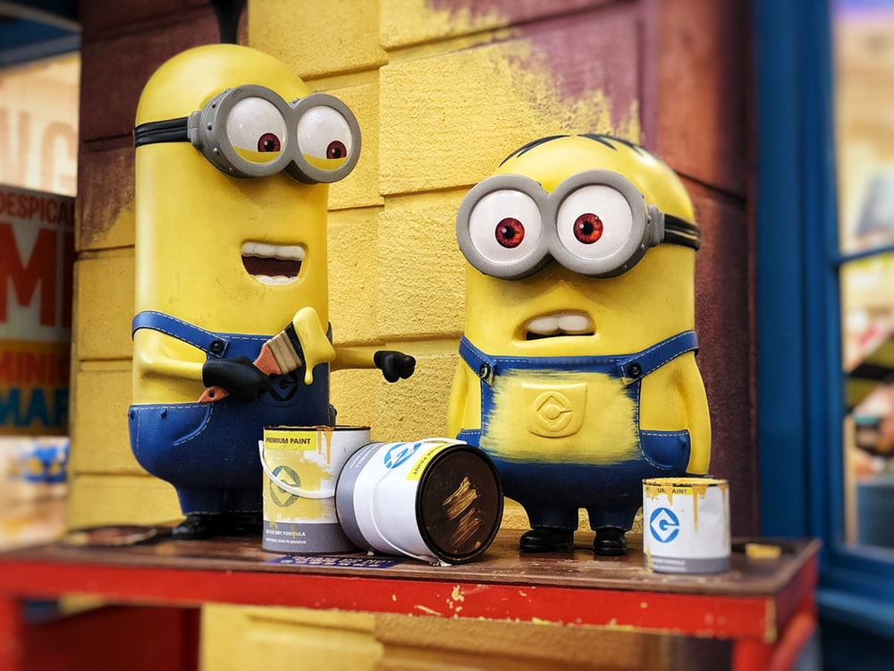


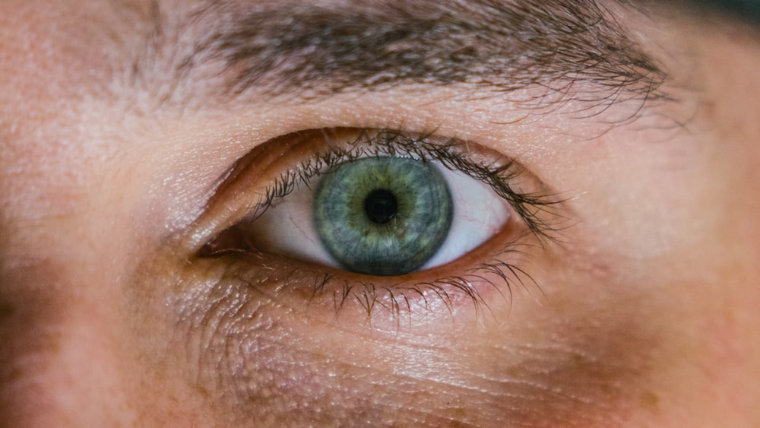
Standard Rules for the Assessment Tool
1. Only humans should be included in the count.
Photo by Alexis Brown on Unsplash
2. A person must be visible enough to be counted.
Photo by Jordan Whitfield on Unsplash
Photo by Eye for Ebony on Unsplash
Notes:
Do not count a close-up part of a face, for example, or a person who is out of focus.

Slide 9


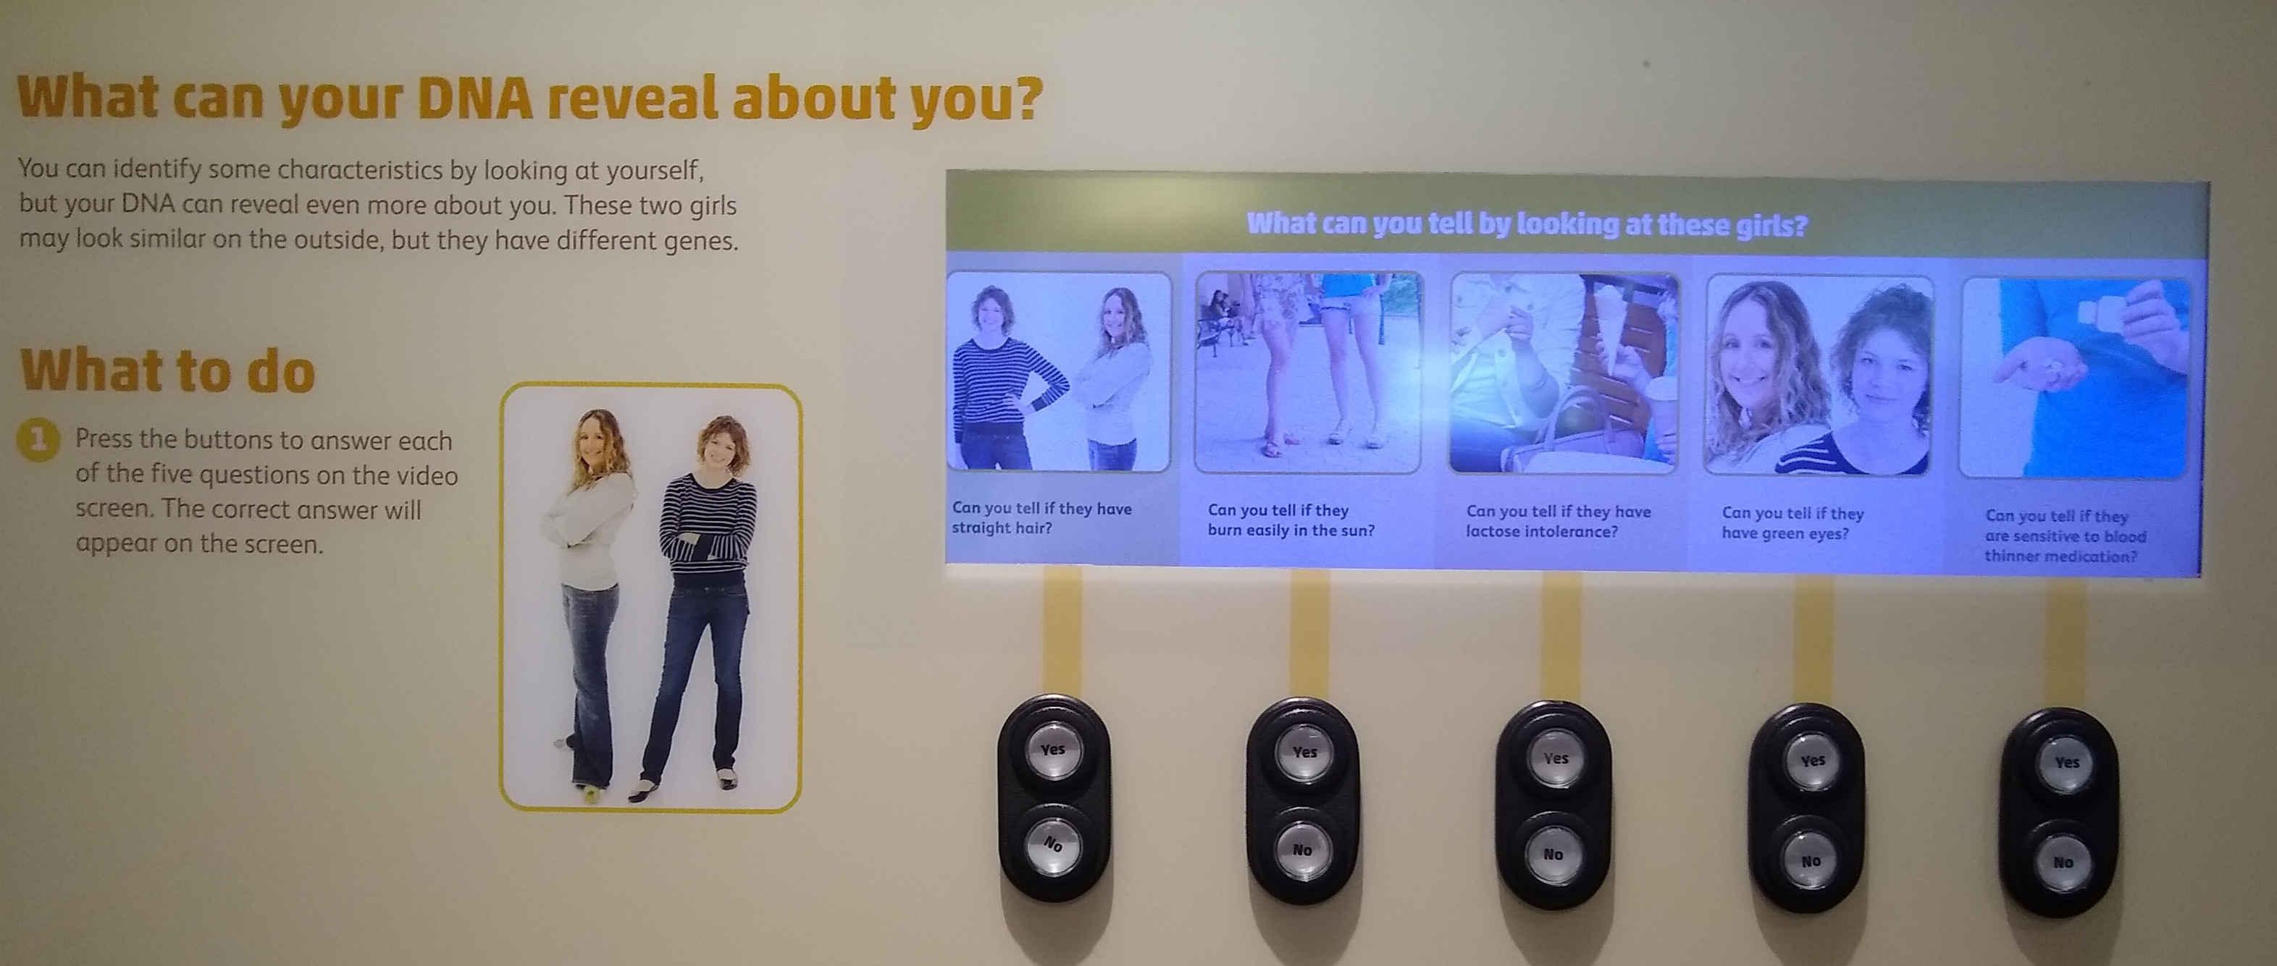
Standard Rules for the Assessment Tool
3. Do not count groups with more than seven people.
Photo by Nicholas Green on Unsplash
Photo by JodyHongFilms on Unsplash
4. A person whose image occurs more than once in an element should only be counted once.
Notes:
3. However, if only one person in a crowd is in focus, that person can be counted.

Slide 10
Standard Rules for the Assessment Tool
For videos:
5. An individual must be visible for at least 5 continuous seconds to be counted
6. Only the first 30 seconds of videos are considered. In the case of looping videos without a discrete beginning or end, assess for 30 seconds at a randomly selected time.

Slide 11
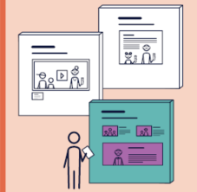
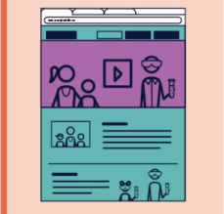

Space
The entirety of a type of media being observed.
A building
A website (or entire online presence)
An ad campaign
An area of signage
All promotional materials or set of program materials

Slide 12
Element
A section of the space.
One area of a building, or one room, etc.
A tab or page within a website
A portion of a set of program materials
The entirety of one flyer

Slide 13
Type
Photos, videos, other
Collect data on only one type at a time.
Use one data collection page to collect data on all photos within an element, and a separate page to collect data on all videos.
Other types may include audio, drawings, sculptures, or any other depictions of people.

Slide 14


Age
Adults
Individuals who appear to be 18 years of age or older
Children
Individuals who appear to be between birth and 17 years of age
Photo by Brooke Cagle on Unsplash
Photo by MI PHAM on Unsplash
Notes:
Note: If you can’t tell if someone is an adult or child, place them in the adult category.

Slide 15
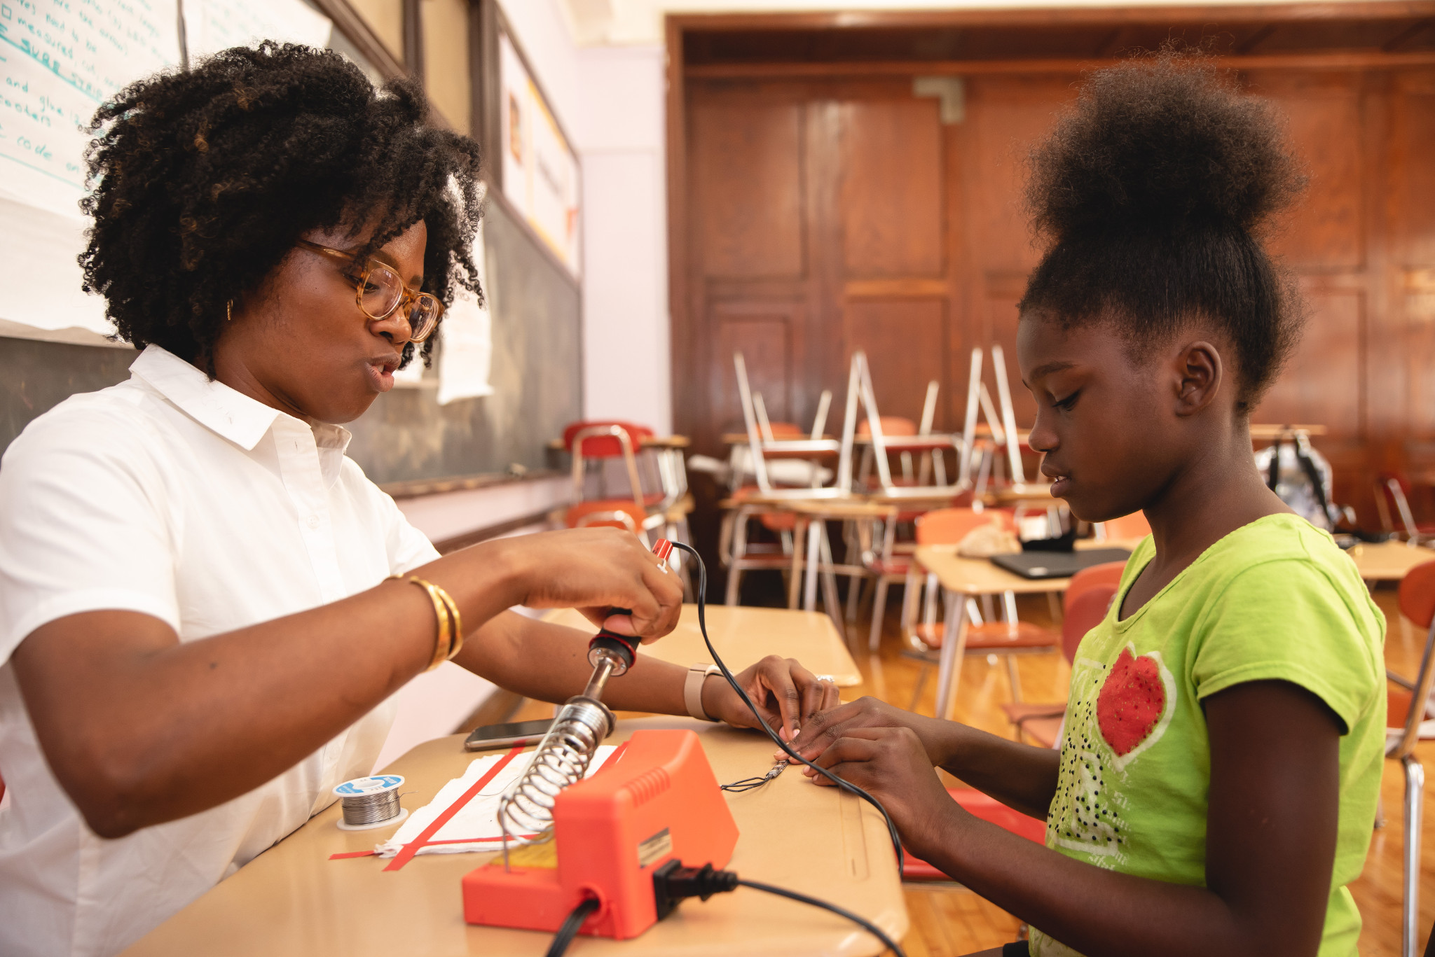
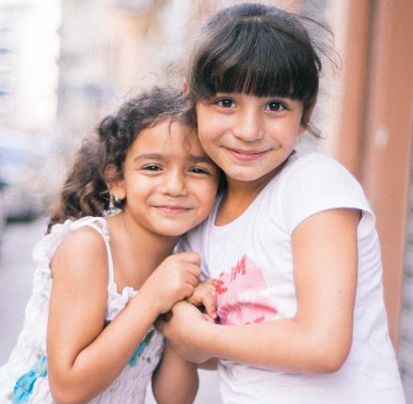
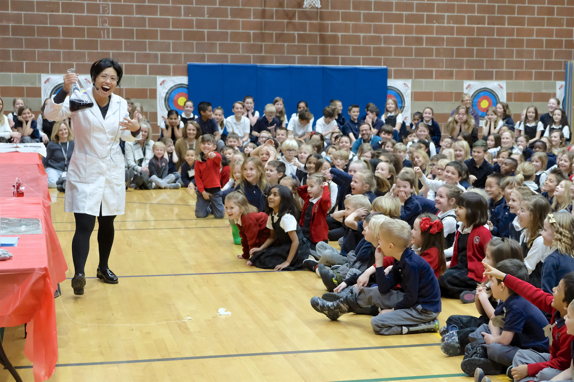
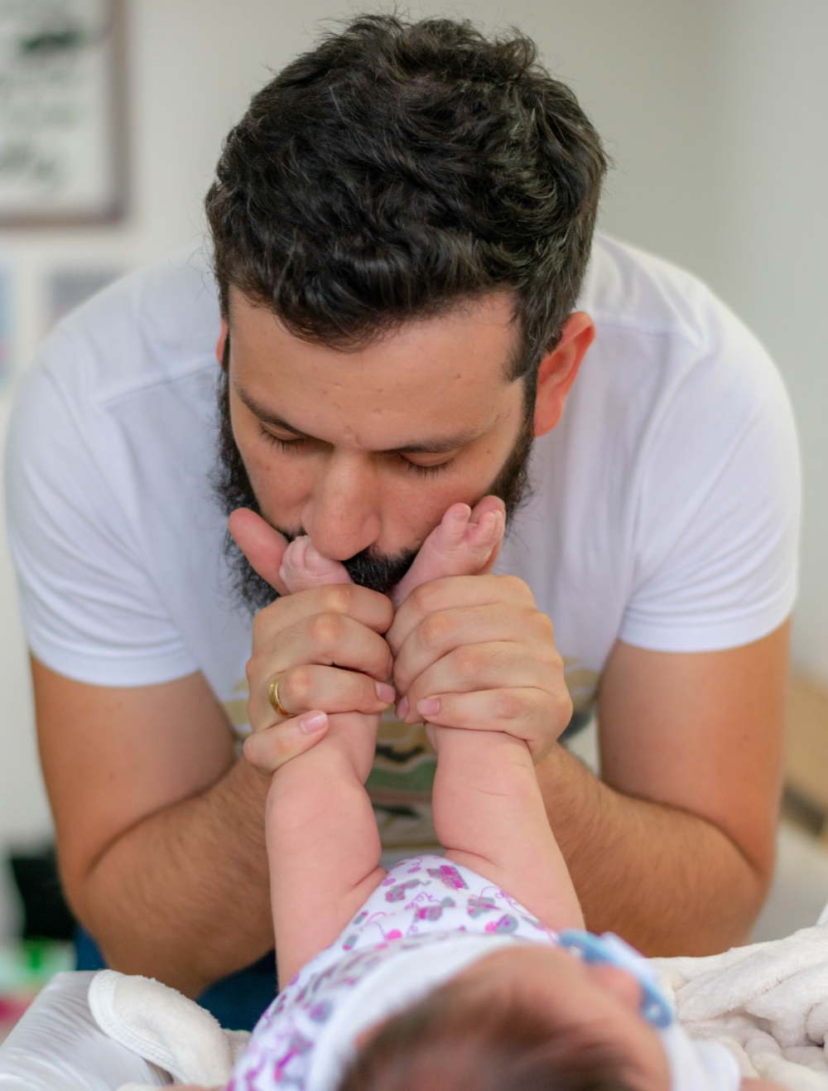
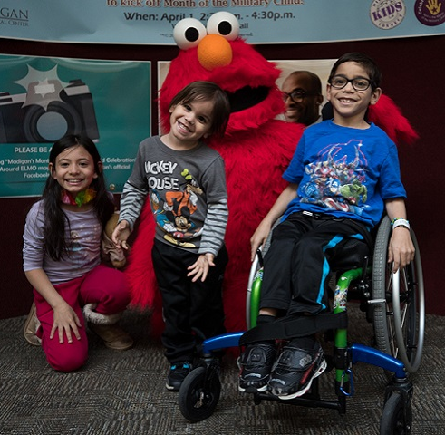
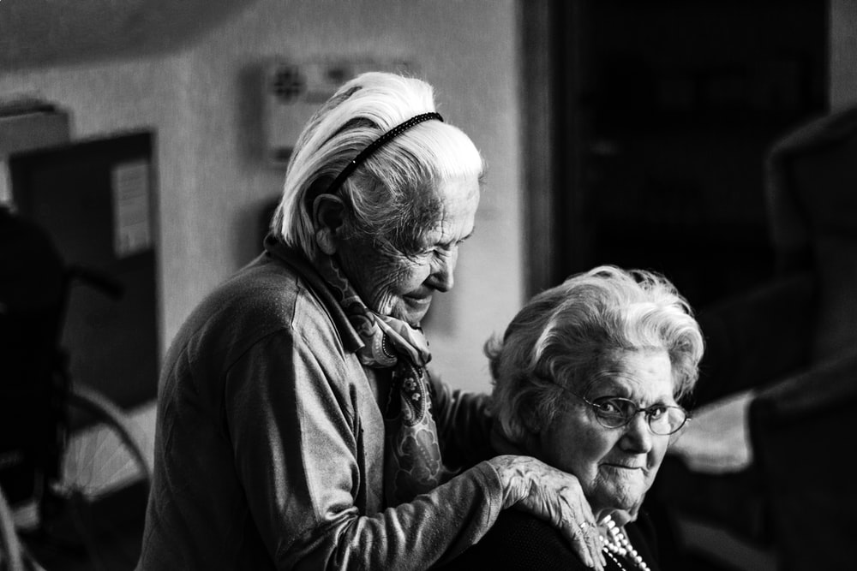

1
2
3
4
Photo courtesy of IF/THEN
Photo by Aleksander Borzenets on Unsplash
6
5
Photo courtesy of IF/THEN
7
Photo by Felipe Salgado on Unsplash
Photo by Eberhard Grossgasteiger on Unsplash
Photo by Omar Lopez on Unsplash
Notes:
Practice: How many adults do you count? How many children?
1: 1 adult 1 child
2: 2 children
3: 1 adult (the children are in a crowd of more than 7 and are not counted)
4: 1 adult (the child’s face is hidden and is not counted)
5: 2 adults
6: 3 children (elmo isn’t counted since he is not human)
7: 3 children (if you or your team decided that these three appear to be too close to 18 to know if they are adults, you may choose to record them as adults instead)
Expected Total: 5 adults and 9 children

Slide 16
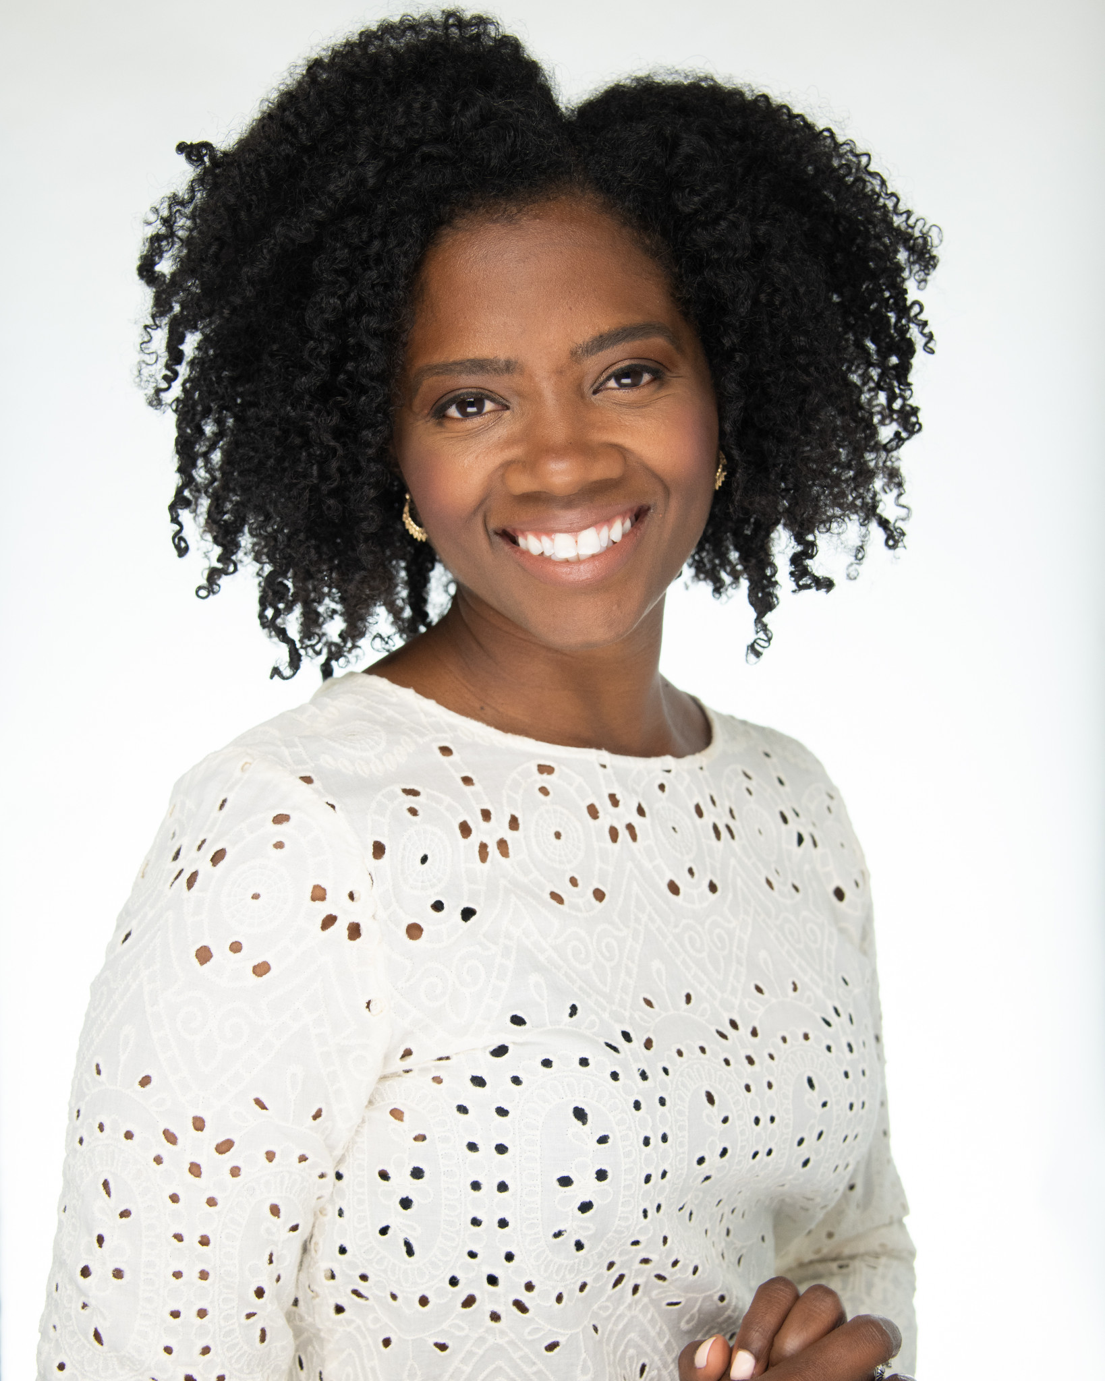


Gender
I perceive this person to be a woman/girl
I do not perceive this person to be a woman/girl or man/boy
You do not think the person is a woman/girl or a man/boy.
or
You can't decide what gender you perceive the person to be.
Photo courtesy of IF/THEN®
I perceive this person to be a man/boy
Photo by Viktor Paris on Unsplash
Photo by Cihan Soysakal on Unsplash
Notes:
The “I do not perceive this person to be a woman/girl or man/boy” category is one way to account for people who may not be a binary gender.

Slide 17
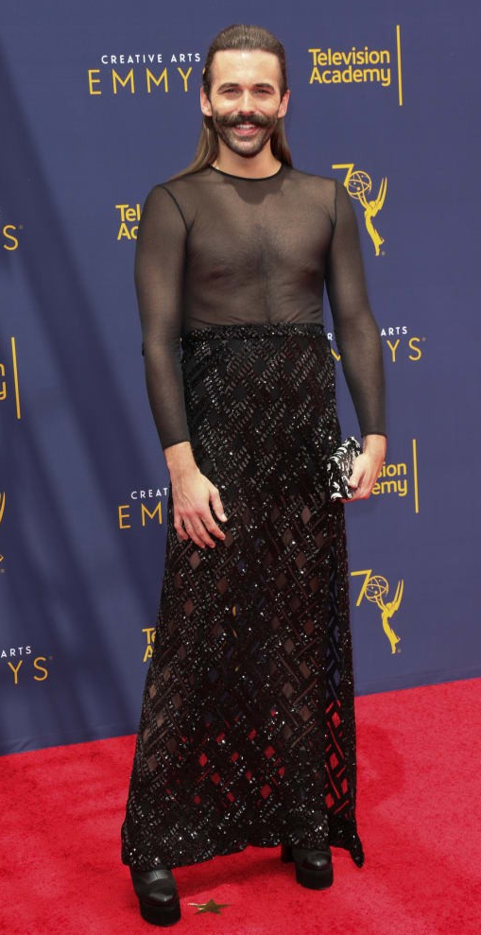
Gender Non-conforming
Gender non-conforming refers to a person who expresses their gender in ways (such as clothing, hair, behavior, and voice) that are primarily different than what is typically expected for their gender.
Photo from Medium.com
Notes:
After marking an individual in either the woman/girl or man/boy category, decide if you perceive them as gender non-conforming. If so, place an additional mark in the gender non-conforming box underneath the gender category you marked initially.
Note:
If you are unsure if you think a person is gender non-conforming, do not mark them as such.

Slide 18
Remember…
  The purpose of this tool is not to decide what someone’s gender identity is, but instead capture your personal perception of gender as it appears in your organization’s content.
  The goal is to better understand what students, staff and visitors will see in your facility — will they feel represented by the images and videos they see?
Notes:
The goal is to better understand what museum visitors will see in your museum- will they feel represented by the images and videos they see?
Keep in mind that when using the tool, you should categorize people based on your initial reactions, which will help the data better reflect what museum visitors are most likely to think when they see an image.

Slide 19

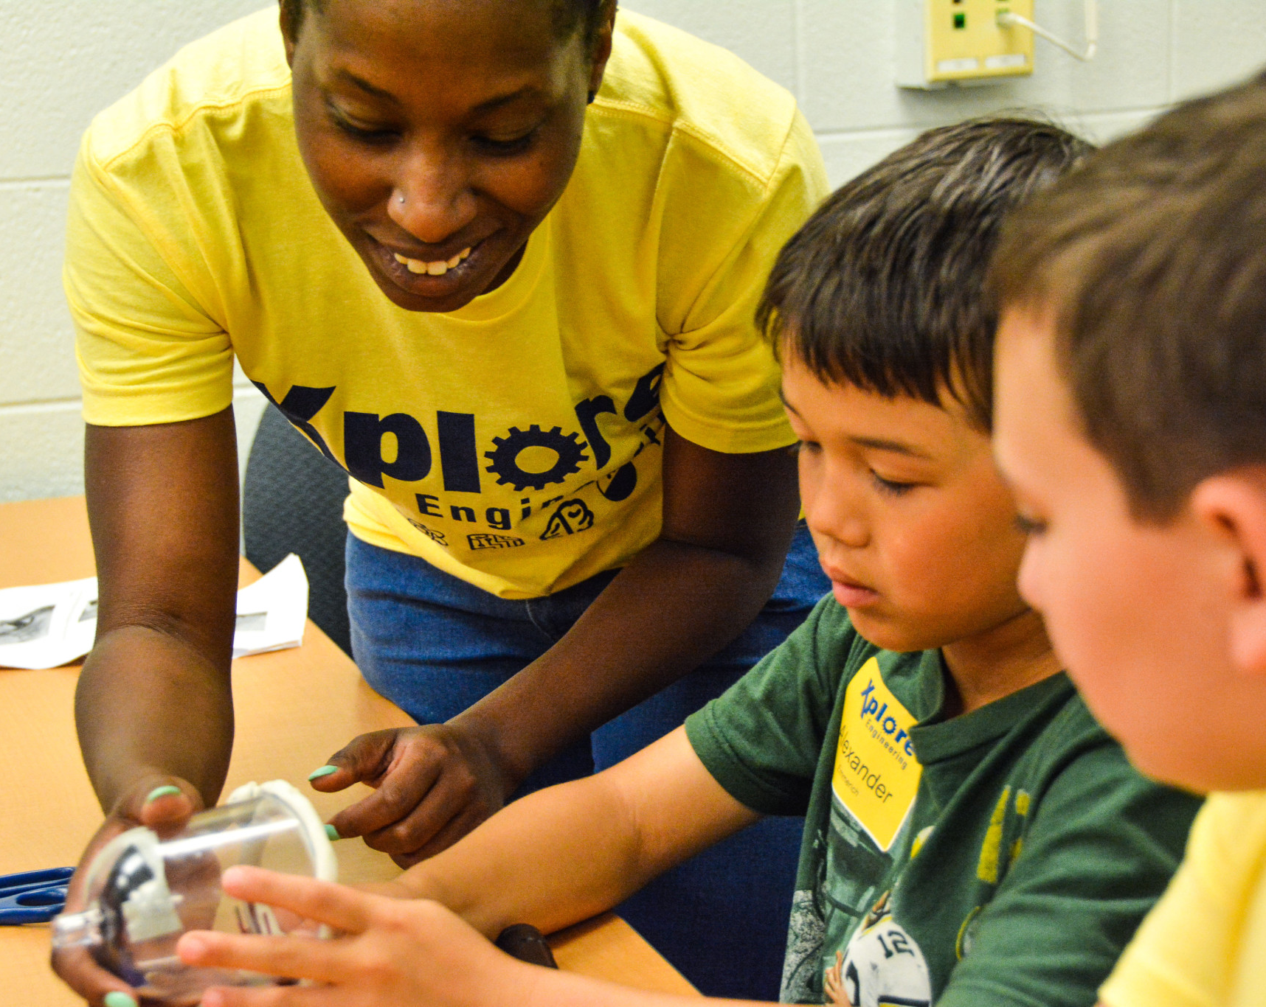






1
2
3
4
Photo courtesy of IF/THEN®
5
Photo by frank mckenna on Unsplash
6
8
Photo by Azamat Zhanisov on Unsplash
7
Photo by Gemma Chua-Tran on Unsplash
Photo by Jorge Saavedra on Unsplash
Photo by Anderson W Rangel on Unsplash
Photo by Brooke Cagle on Unsplash
Notes:
Use the tool to record the people you see in these images.
1: You may choose to only count the child in green since the second child’s face is hard to see
4: Unisex uniforms typically should not be taken into account when deciding if someone is gender non-conforming
7: You may choose not to count the person facing away from the camera.
8: Some may choose to mark this person under “I do not perceive this person to be a man or a woman”, while some may choose to mark them as “I perceive this person to be a man” and place a mark in the “gender non-conforming” line (or, some may choose a different option altogether!). All choices are ok as long as it reflects what the data collector perceives. There does not need to be agreement among data collectors about the “right” choice.

Slide 20
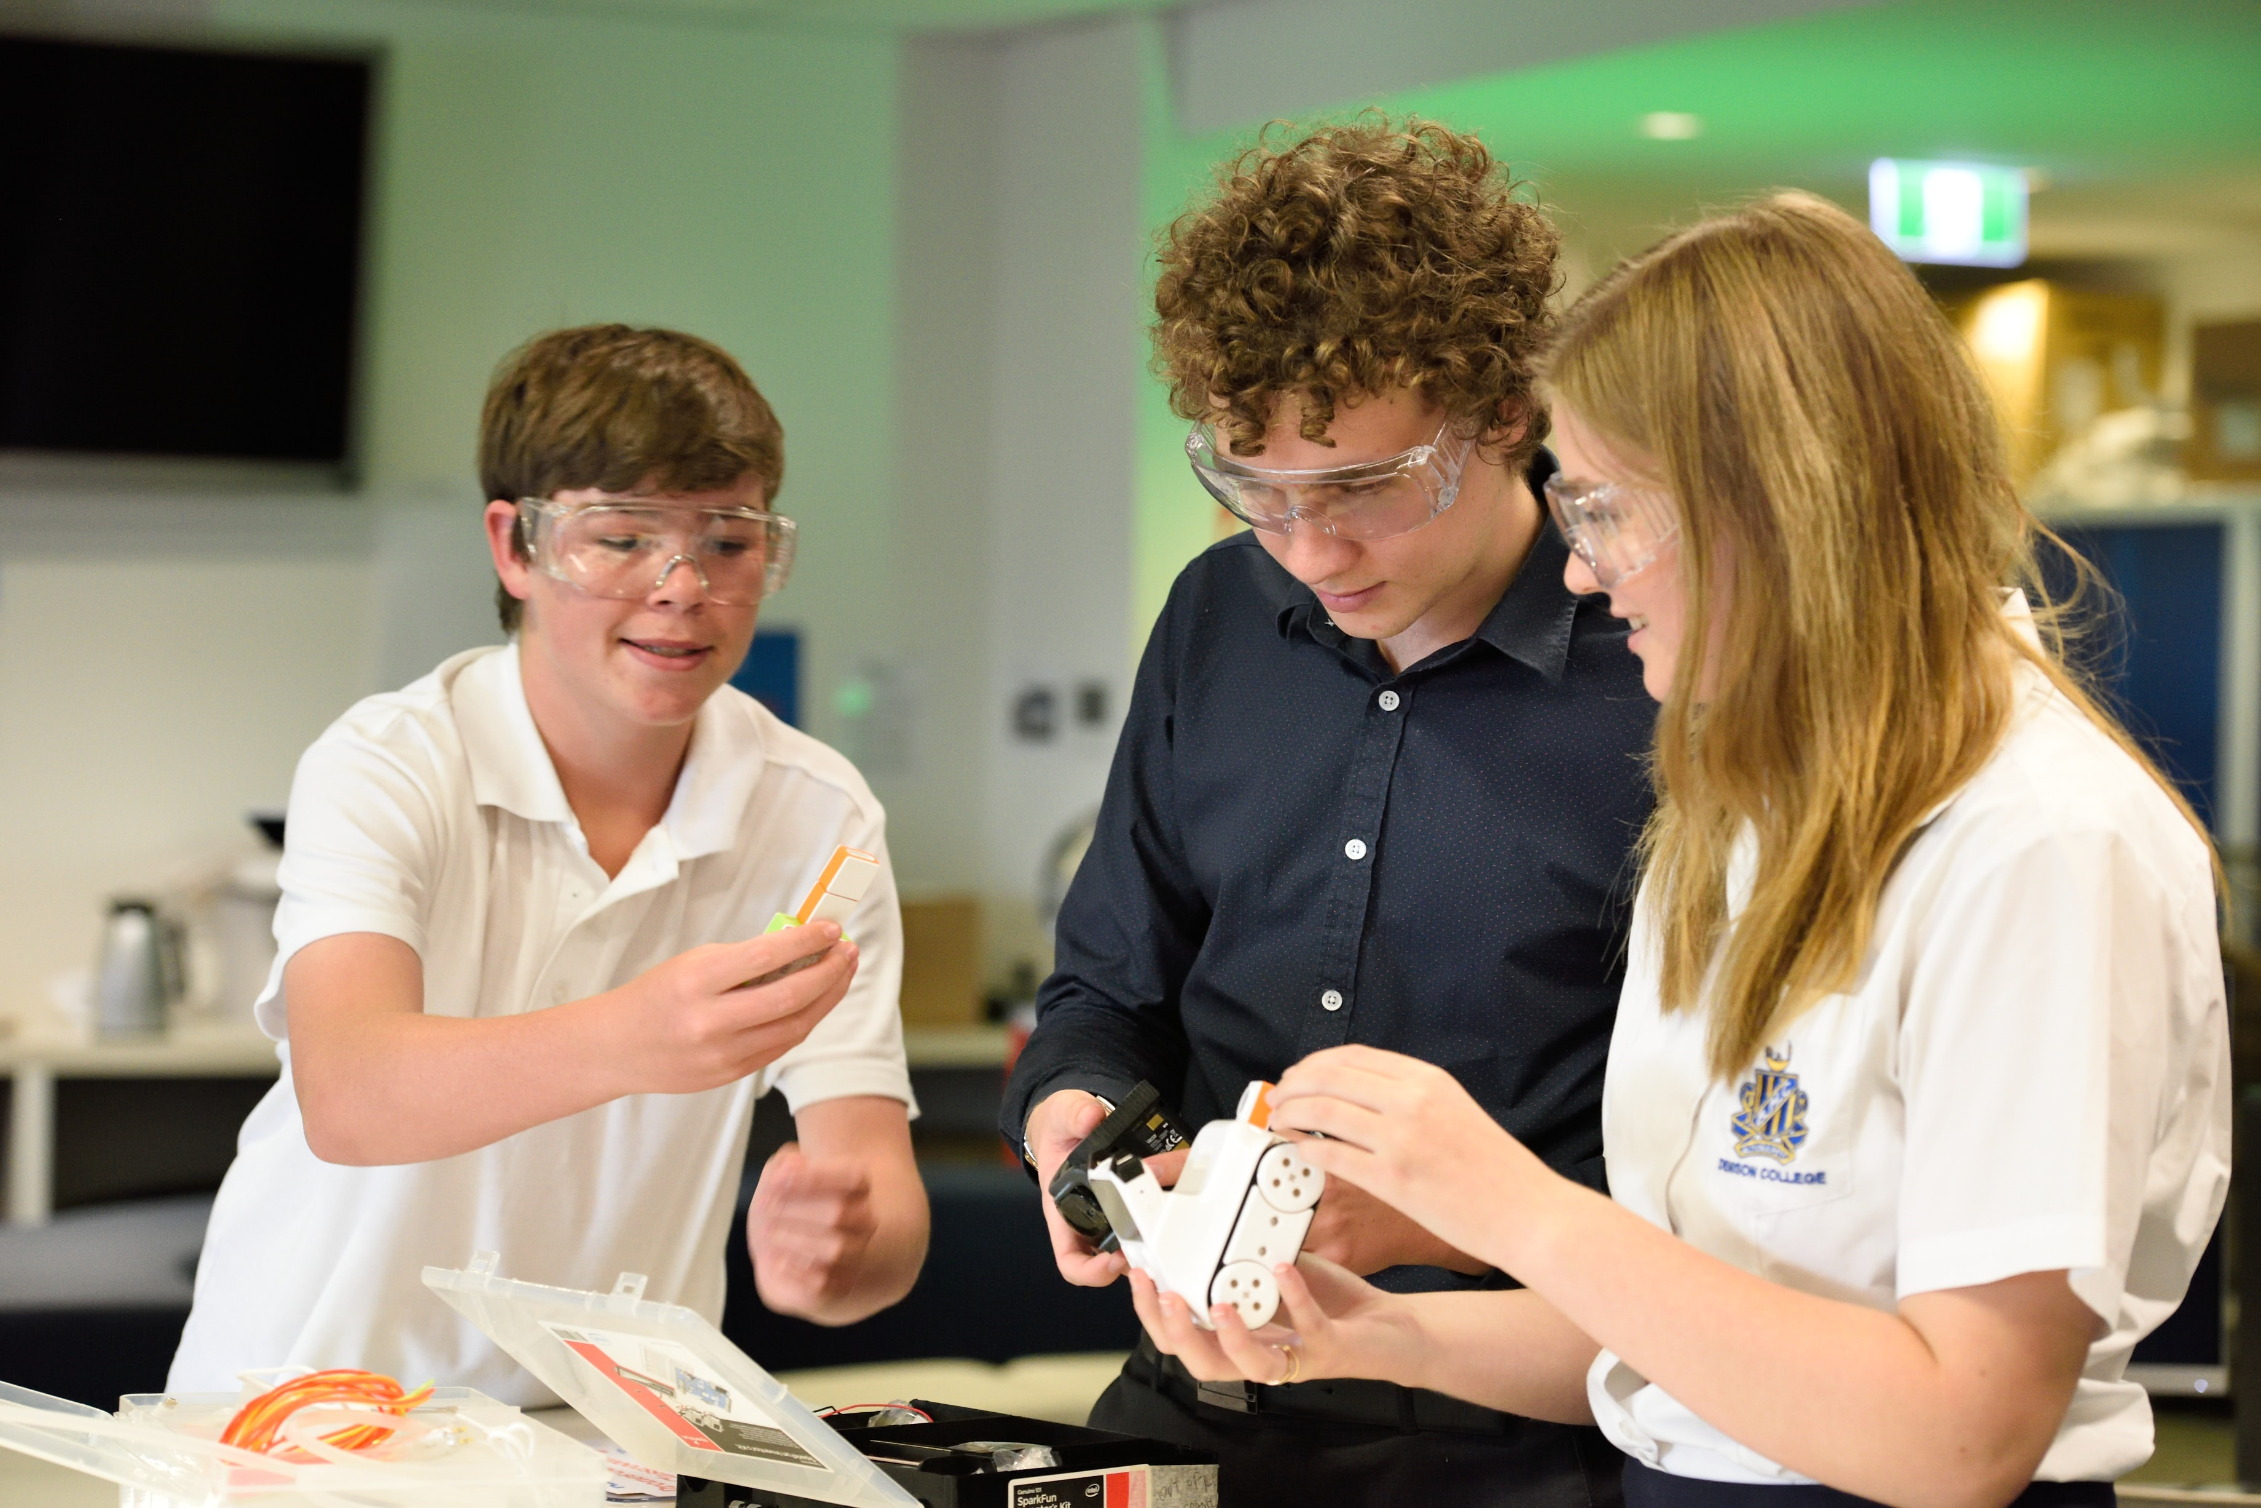
STEM
STEM Professional - Adults
Adults who appear to be a STEM professional
Doing STEM - Children
Children who appear to be engaging in a STEM activity
Photo courtesy of IF/THEN
Photo by stem.T4L on Unsplash
Notes:
STEM Professional:
Adults who appear to be a STEM Professional based on their clothing (e.g., a lab coat), job-related tools/instruments, or actions.
Doing STEM:
Children who appear to be engaging in a STEM activity (e.g., actively participating, using a scientific tool to observe or measure).

Slide 21
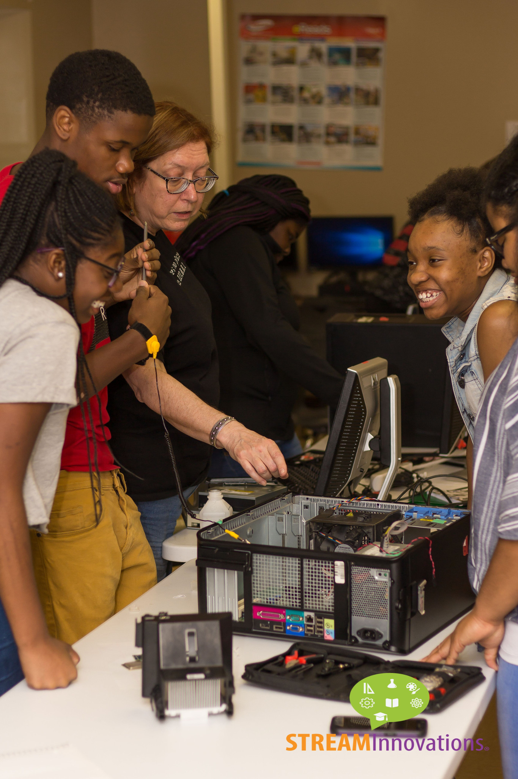
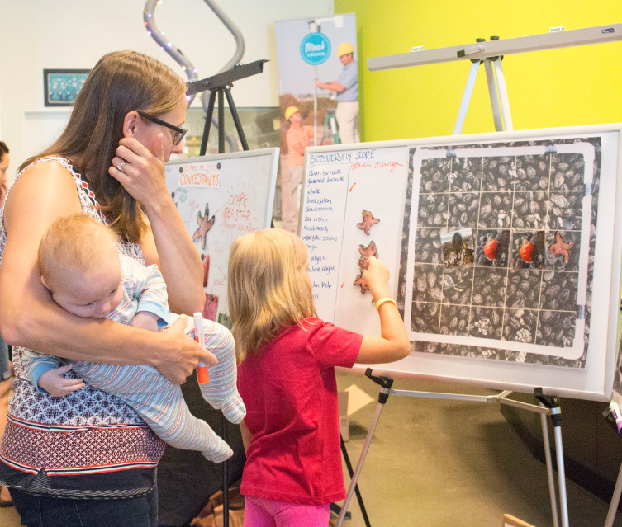
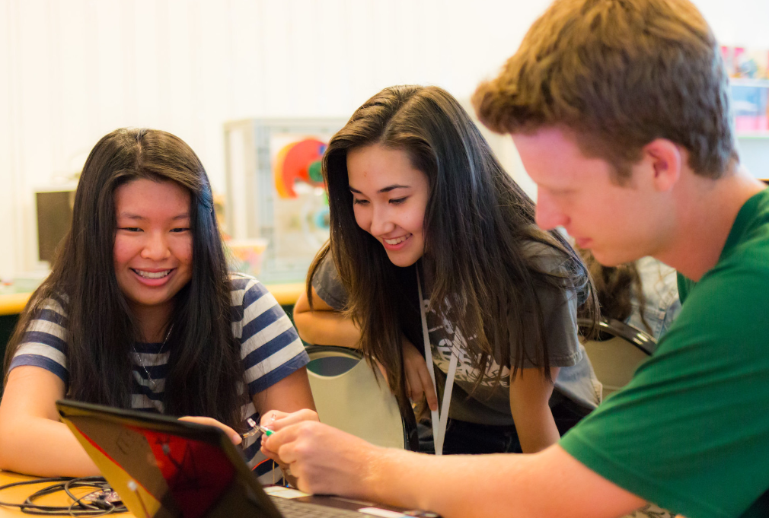
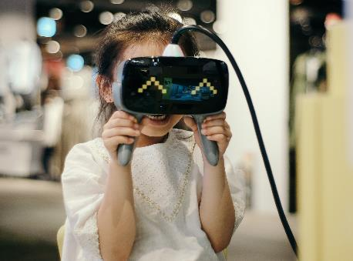
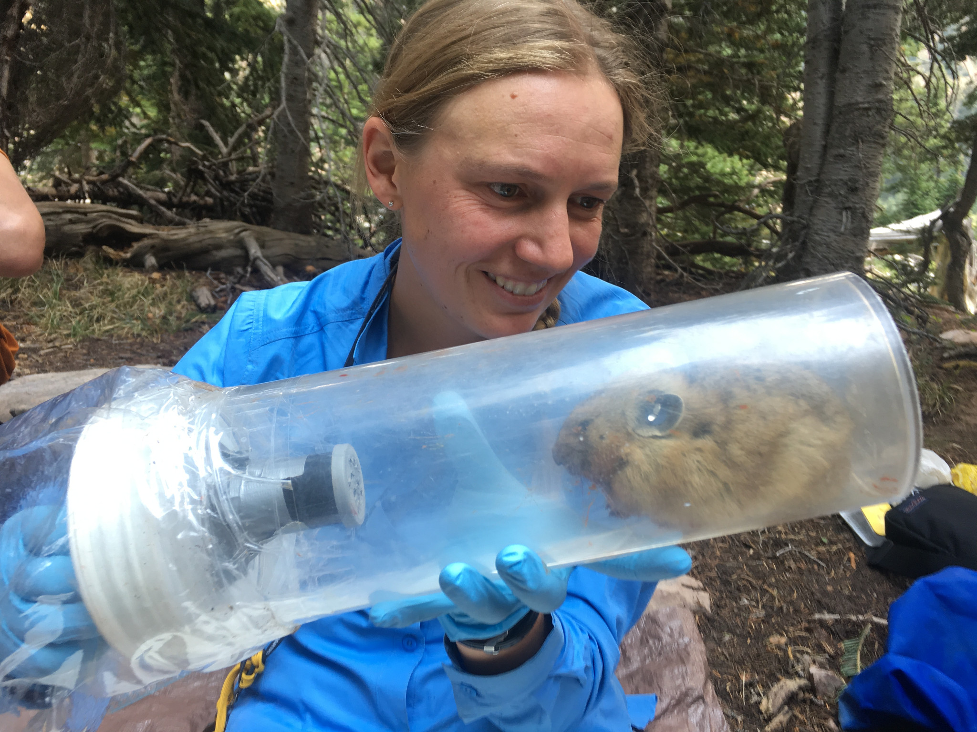
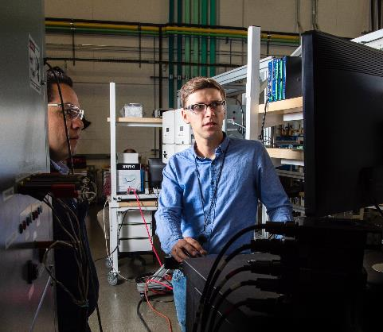
Photo courtesy of OMSI
Photo courtesy of OMSI
Photo courtesy of IF/THEN
Photo by insung yoon on Unsplash
Photo by Science in HD on Unsplash
Photo courtesy of IF/THEN
Notes:
Use the tool to record the people you see in these images.

Slide 22
Additional Categories
  Will your organization want to collect data on additional representation categories? Which ones?
  How will you define who to include in these categories?

Slide 23
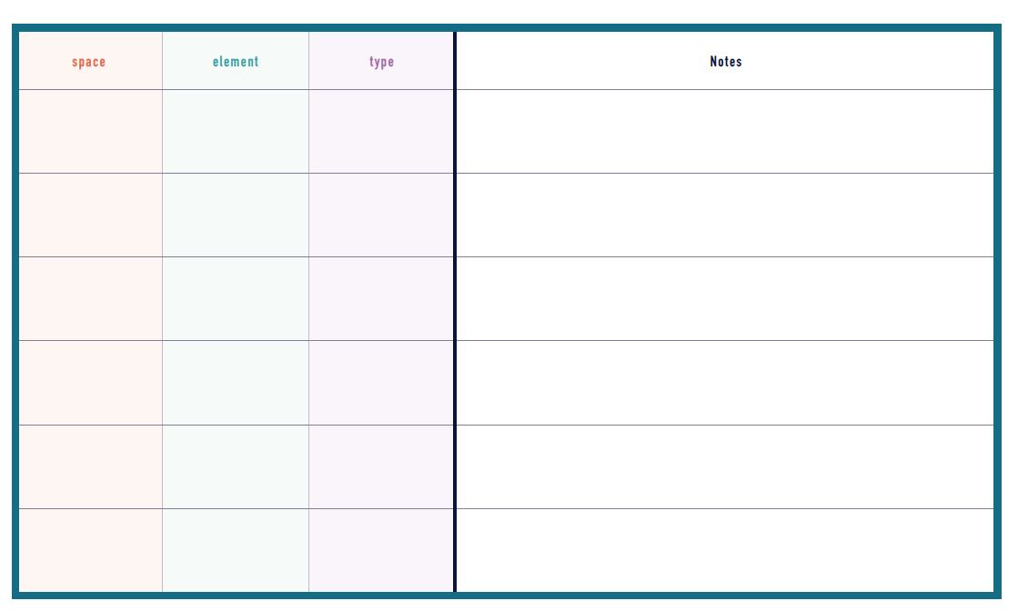
Notes
Use the notes page to record patterns, stereotypical images, or anything else you may want to discuss during the debrief session after you collect data.

Slide 24
Logistics
  Who will collect data from each space?
  When should the data collection be completed?
  Who should data collectors give their data to after it is collected?
  What should data collectors do if they have questions as they collect data?

Slide 25
What do you think?
  What percentage of the images and videos in your institution will feature women?
  What percentage of the STEM professionals will be women?
  How many images of gender non-conforming individuals will you find?
  If you are collecting data on additional categories, what do you think you will find?

